Slide 1
CEC Wind Turbine Project
October 29th, 2021

Slide 2
Wind Turbine Vibrations that We Can Simulate
Offshore
Wind
Wave
Blade vibration
Onshore
Wind
Earthquake (Dissertation, Page 64)
Blade vibration

Slide 3
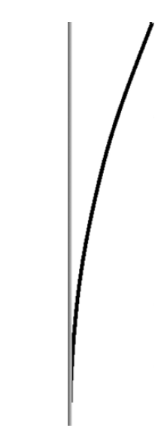
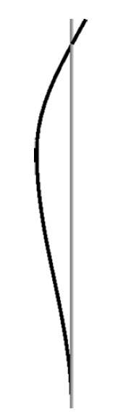
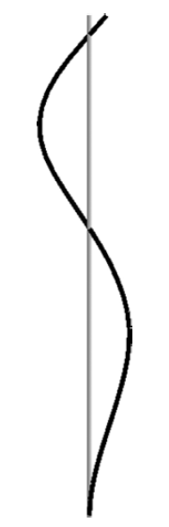
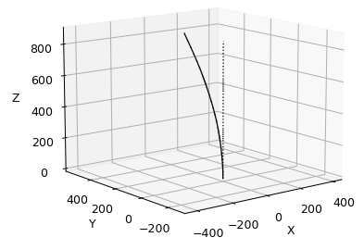
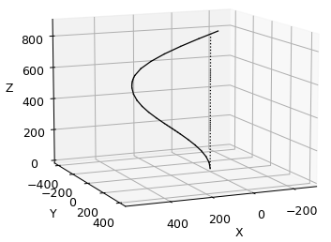
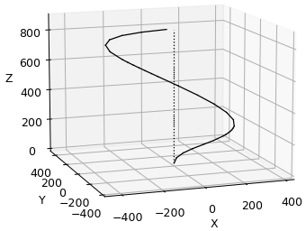


Recap: OpenSees Model (github)
Our OpenSees Model
First Mode: $ω_{n}=1.74 Hz$
Second Mode: $ω_{n}=12.8 Hz$
Third Mode: $ω_{n}=37.16 Hz$
Literature Review
First Mode: $ω_{n} \text{≈} 1.7 Hz$
Second Mode: $ω_{n} \text{≈} 11.8 Hz$
Third Mode: $ω_{n} \text{≈} 34.1 Hz$

Slide 4
Determining for the Sinusoidal Motions to Apply
Typical Wave periods in the Morro Bay and Humboldt Bay
National Oceanic and Atmospheric Administration (NOAA) has a large database of wave properties
Wave frequency and magnitude dependent on seasons
Usually, 1-3 Hz for wave frequency
Sea State: General condition of the free surface of the body of water
Local wind wave (Generally 3-6 second period)
Fresh Swell (Wave generation region well upstream) (Generally 7-10 second period)
Pure Swell (Wave generation region well upstream) (Generally greater than 10 second period)

Slide 5
Determining for the Sinusoidal Motions to Apply
Typical Wave periods in the Morro Bay and Humboldt Bay
Waves have 3 significant properties
Height
Period
Direction

Slide 6
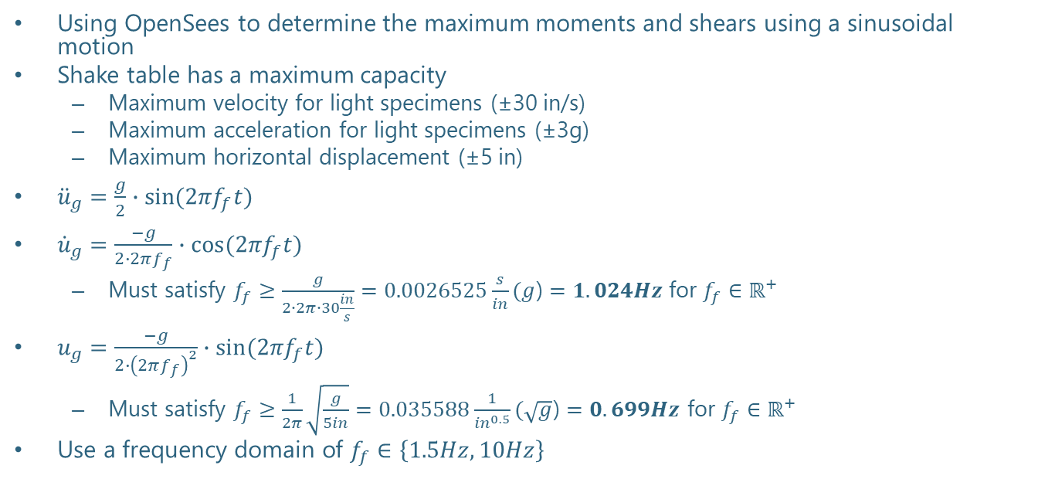
OpenSees Model Results
Using OpenSees to determine the maximum moments and shears using a sinusoidal motion
Shake table has a maximum capacity
Maximum velocity for light specimens (±30 in/s)
Maximum acceleration for light specimens (±3g)
Maximum horizontal displacement (±5 in)
${\ddot{u}}_{g}=\frac{g}{2}∙sin{{(2πf}_{f}t)}$
${\dot{u}}_{g}=\frac{−g}{2∙2πf_{f}}∙cos{{(2πf}_{f}t)}$
Must satisfy $f_{f}≥$ $\frac{g}{2∙2π∙30\frac{in}{s}}=0.0026525\frac{s}{in}(g$) $=1.024Hz$for $f_{f}∈ℝ^{+}$
$u_{g}=\frac{−g}{{2∙\left(2πf_{f}\right)}^{2}}∙sin⁡{(2πf}_{f}t)$
Must satisfy $f_{f}≥\frac{1}{2π}\sqrt{\frac{g}{5in}}=0.035588\frac{1}{{in}^{0.5}}(\sqrt{g}$) $=0.699Hz$ for $f_{f}∈ℝ^{+}$
Use a frequency domain of $f_{f}∈\left\{1.5Hz, 10Hz\right\}$

Slide 7
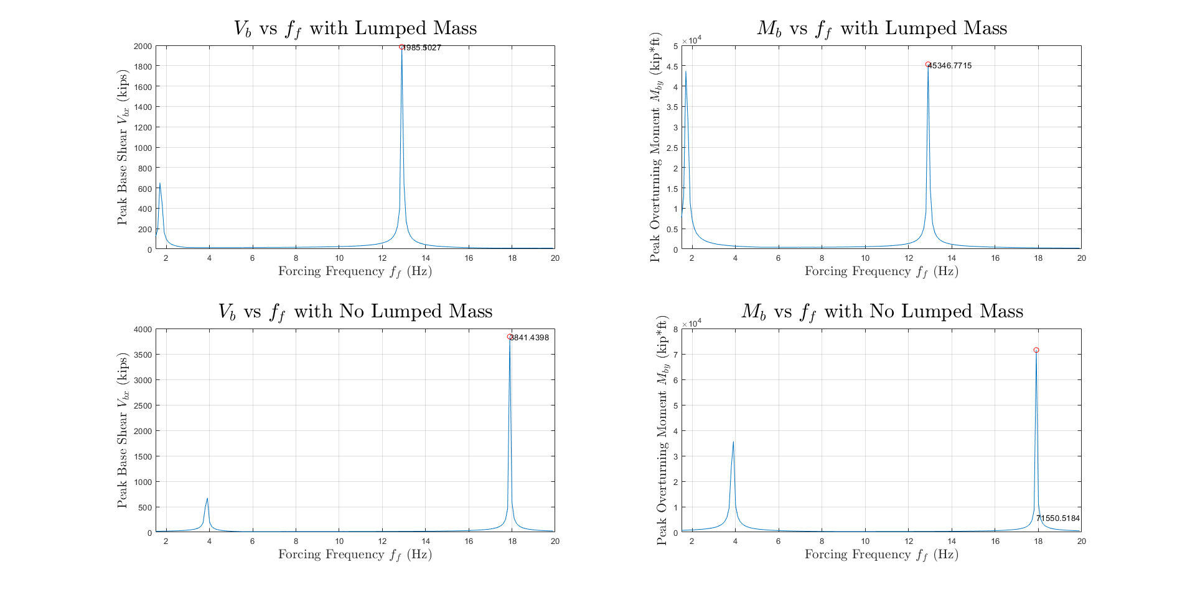
OpenSees Model Results

Slide 8
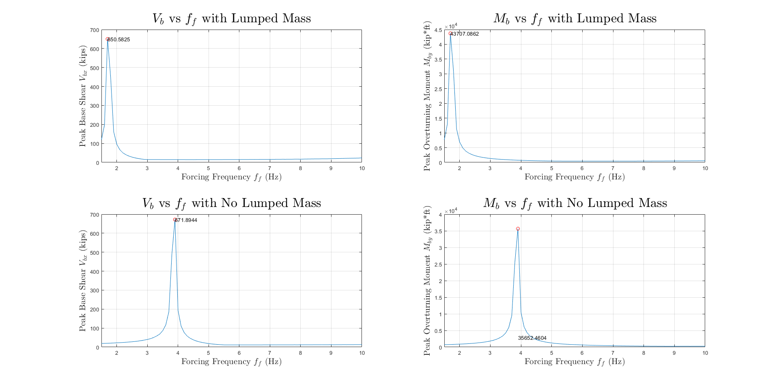
OpenSees Model Results

Slide 9
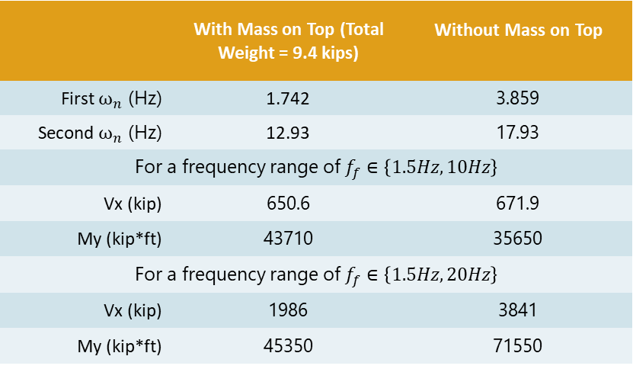
OpenSees Model Result Summary
 | With Mass on Top (Total Weight = 9.4 kips) | Without Mass on Top
First $ω_{n}$ (Hz) | 1.742 | 3.859
Second $ω_{n}$ (Hz) | 12.93 | 17.93
For a frequency range of $f_{f}∈\left\{1.5Hz, 10Hz\right\}$
Vx (kip) | 650.6 | 671.9
My (kip*ft) | 43710 | 35650
For a frequency range of $f_{f}∈\left\{1.5Hz, 20Hz\right\}$
Vx (kip) | 1986 | 3841
My (kip*ft) | 45350 | 71550

Slide 10
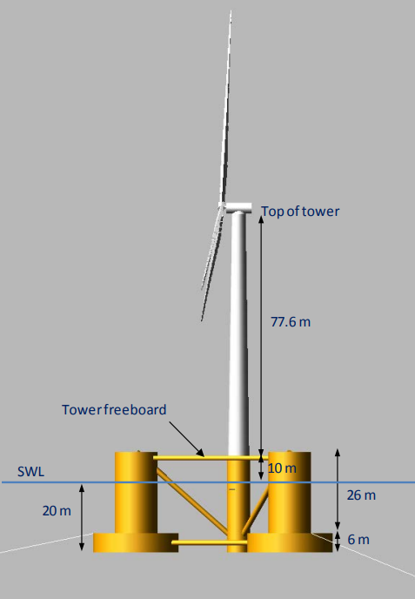
OpenFAST
Using an existing prototype
Verified by NREL (‘Gold Standard’)
Generating wind and wave datasets (site-specific) to run the simulation
Semi-Submersible Design support structure
Currently working on the OpenFAST OC4-DeepCwind semisubmersible model (github.com/OpenFAST) (Documentation)

Slide 11
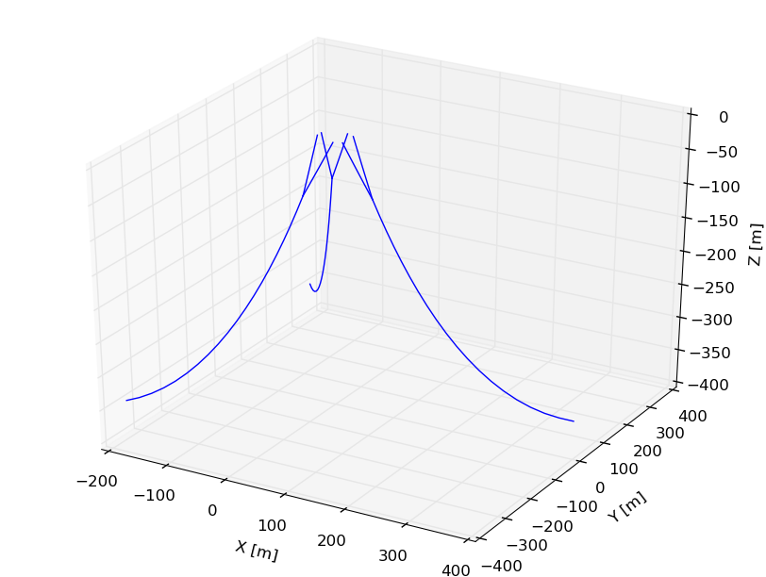
Mooring Analysis
MAP++: Mooring Analysis Program by NREL
Models steady-state forces on a Multi-Segmented, Quasi-Static mooring line
Motivation: Tall water column (1000m vs typical 60-80m)
Solving catenary equations, MAP++ solves static models
Ignores inertia forces and fluid drag loads
Only accounts for the mean forces
Elasticity
Weight
Geometric nonlinearities

Slide 12
To-Do
Waiting on Arpit on bolt pattern specifics
Order base plate after finalizing design
Paper work in progress for the UCSD turbine shipment
Getting quotes for different shipping companies
Access to the CEC Box to upload files
Continue OpenFAST modeling for the UCSD turbine and the prototype
Finish frequency vs moment plot

Slide 13
OpenSees Model Results
Spatial CQC3 vs Modal CQC
Will we be running ground motions in orthogonal directions?
Peak response due to multicomponent ground motion shake table test (See Chopra Chapter 13)
Spatial SRSS or CQC3?
If two horizontal components of ground motion are equal, then the CQC3 rule reduces to the spatial SRSS rule

Slide 14
Test Logistics
Amarnath recommended using Bragg Crane Richmond for crane and rigging
Load range for the bend test
Hand Calcs:
SAP2000 Results:
Support Options
Several Plywood supports

